Slide 1
Java 8

Slide 2
Topic Agenda
Date And Time API

Slide 3
Date And Time API
Java 8 introduces a new date-time API under the package java.time.
Java 7 date-time API is under java.util package which include classes like Date, Calendar, Gregorian calendar , etc.
Why do we need new Date and Time API?
Not thread safe
Poor design
Difficult time zone handling

Slide 4
Date And Time API
Changes to Date and Time API
Immutability and thread safety: Classes in the new Date Time API are immutable and good for multi threaded environments.
Clarity: It defines separate classes for Date, Time, DateTime, Timestamp, Timezone etc. and separates clearly between human readable date time and machine time .
Easy to use: All the new Date Time API classes comes with methods to perform common tasks, such as plus, minus, format, parsing, getting separate part in date/time etc. rather than having a separate class for them.

Slide 5
Date And Time API
java.time Package
contains the core of the API for representing date and time. It includes classes for date, time, date and time combined, time zones, instants, duration, and clocks
Common Classes in java.time Package
java.time.LocalDate: This stores the date part of date-time in terms of years-months-days. It does not store the Timezone. The class is immutable.
java.time.LocalTime: This class stores the time part of date time without any Timezone info.
java.time.LocalDateTime: This class stores the LocalDate and LocalTime but no Timezone.

Slide 6
Date And Time API
Common Classes in java.time Package
java.time.Period: This class represents the date part of the datetime. It represents the date part in terms of days, months and years. for example 1 year, 2 months and 5 days.
java.time.Duration: This class represents the time part of the datetime. It represents the time part in terms of seconds and nanoseconds. for example ’29 seconds’.
java.time.Instant: This represents a particular instant in the timeline. It stores the number of seconds through epoch time and also has another field that stores the nanoseconds.
java.time.ZonedDateTime: This is an immutable representation of a date-time with a time-zone.

Slide 7
Date And Time API
Sub Packages in java.time Package
The java.time package also contains four sub packages which contain more utilities etc.
java.time.chrono-contains the API for representing calendar systems other than the default ISO-8601. For example, Hijrah calendar, ThaiBuddhist calendar, etc.
java.time.format-Classes for formatting and parsing dates and times.
java.time.temporal- contains API allowing interoperations between the date and time classes, querying, and adjustment. For example, TemporalField and ChronoField.
java.time.zone- Presents classes that support time zones and their rules

Slide 8
Date And Time API
How to get today's date and time in Java 7
Date date = new Date();
// display time and date using toString()
System.out.println(date.toString());
Output
Wed Dec 09 17:50:40 IST 2015
It contains both date and time part and prints data non formatted.Date and SimpleDateFormatter class are not thread-safe,
Leading to potential concurrency issues for users.

Slide 9
Date And Time API
How to get today's date in Java 8
LocalDate today = LocalDate.now();
System.out.println("Today's Local date : " + today);
Output:
Today's Local date : 2014-01-14
It has created today's date without any time information. It also print the date in nicely formatted way. All the classes in the new Date Time API are immutable and good for multithreaded environments.

Slide 10
Date And Time API
How to get current Time in Java 8
LocalTime time = LocalTime.now();
System.out.println("local time now : " + time);
Output:
local time now : 16:33:33.369 // in hour, minutes, seconds, nano seconds
Current time has no date attached to it, because Local Time is just time, no date.

Slide 11
Topic Agenda
Streams

Slide 12
Streams
Java provides a new additional package in Java 8 called java.util.stream
This package consists of classes ,interfaces and enum to allow functional style operations on elements.
What are Streams??
A Stream in Java is a sequence of elements supporting parallel and aggregate operations.
Why Streams?
process data in a declarative and more functional way.
Efficiency -leverage multicore architecture without the need to write any specific code for it.

Slide 13
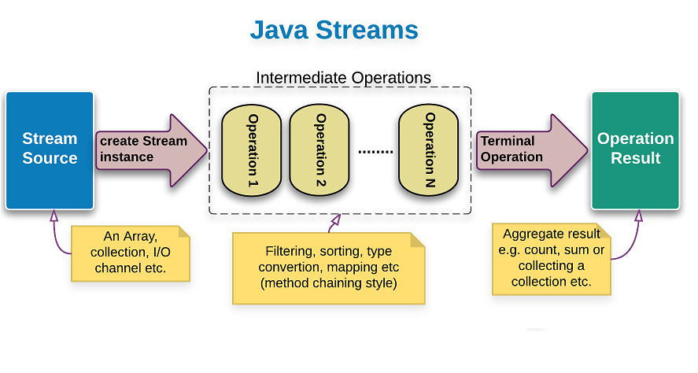
Streams
3 important components –
a source,
1 or more intermediate operations
a terminal operation.
These 3 are pipelined in a sequence to make a stream work.

Slide 14
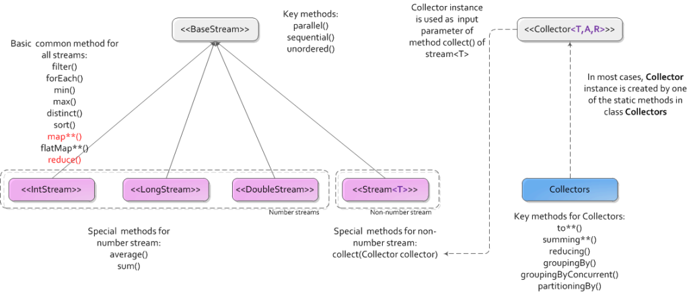
Streams Package View

Slide 15
Streams
To understand the definition of stream in its totality we need to understand each of these terms.
Sequence of elements – A stream provides an interface to a sequenced set of values of a specific type. For e.g. Stream<Integer> is a stream of type Integer.
Source– Streams are defined as originating from a specific source which can be collections, arrays, input-output(I/O) resources etc.
Operations on stream elements –Several pre-defined operations can be declared to act on the stream elements to map, reduce and collect these elements.
Parallel and Aggregate/Seq operations – The operations working on these stream of elements can work in parallel on multi-core architectures.
Aggregate operations act on elements in the stream in a sequence and end up aggregating data into an end value.

Slide 16
Streams
Pipeline of Operations – Java 8 streams are designed in such a way that most of stream operations return stream only. This help us creating chain of various stream operations. This is called as pipelining i.e. output of one stream operation acts as input of the next stream operation.
Internal iterations– In Java we traditional use loop or iterators to iterate through the collections. These kind of operations are called as external iterations and they are clearly visible in code.
Java 8 stream operations has methods like foreach, map, filter etc. which internally iterates through the elements. The code is completely unaware of the iteration logic in the background. These kind of iterations is called as internal or automatic iterations .

Slide 17
Stream
Intermediate Operations: Intermediate Operations are invoked on a Stream instance and after they finish their processing they give a Stream instance as output.
Zero or more intermediate operations which transform a stream into another stream, such as filtering, sorting, element transformation (mapping).
Terminal Operations: Terminal operations are responsible for giving the ‘final’ output for a Stream in operation, and in the process they terminate a Stream.
Terminal Operations thus do not return a Stream as their output.

Slide 18
Stream
Pipelining:
Stream operations: intermediate and terminal operations, are combined to form stream pipelines.
A stream pipeline consists of a source (such as a Collection, an array, a generator function, or an I/O channel); followed by zero or more intermediate operations such as Stream.filter or Stream.map; and a terminal operation such as Stream.forEach or Stream.reduce.

Slide 19
Streams
Streams vs Collections
No storage. A stream is not a data structure that stores elements; instead, it conveys elements from a source such as a data structure, an array, a generator function, or an I/O channel, through a pipeline of computational operations.
Functional in nature. An operation on a stream produces a result, but does not modify its source.
Laziness-seeking. Streams can be seen as lazy constructed collections where the values are computed when user demands for it.
Possibly unbounded. While collections have a finite size, streams need not
Consumable. The elements of a stream are only visited once during the life of a stream, so there is no way to create a reference to stream for future usage. Since the data is on-demand ,it’s not possible to reuse the same stream multiple times

Slide 20
Create Streams using Stream class
Different ways to create Stream
1. Creating a Stream from values
Using Stream.of(val1,val2,val3...)
2. Creating a Stream from arrays
Using Stream.of(arrayOfElements)
Stream<Integer> stream1=Stream.of(1,2,3,4,5,6,7,8,9,10);
stream1.forEach(System.out::println);
Integer[] integerArray=new Integer[]{1,2,3,4,5,6,7,8,9,10};
Stream<Integer> stream2=Stream.of(integerArray);
stream2.forEach(System.out::println);

Slide 21
Create Streams
Using Arrays.stream(arrayname)
String[] names = {"Lewis Carrol", "H.G. Wells", "Michael Ende"};
Stream<String> stream4 = Arrays.stream(names); stream4.forEach(System.out::println);
int[] integers = {1, 4, 6, 2, 6, 3, 2};
IntStream stream5 = Arrays.stream(integers);
stream5.forEach(System.out::println);

Slide 22
Create Streams
3. Creating a Stream from a Collection
stream() − Returns a sequential stream considering collection as its source.
parallelStream() − Returns a parallel Stream considering collection as its source.
List <Integer> list=new ArrayList<>();
for(int i=1;i<=10;i++){
list.add(i);
}
Stream<Integer> stream=list.stream();
stream.forEach(System.out::println);

Slide 23
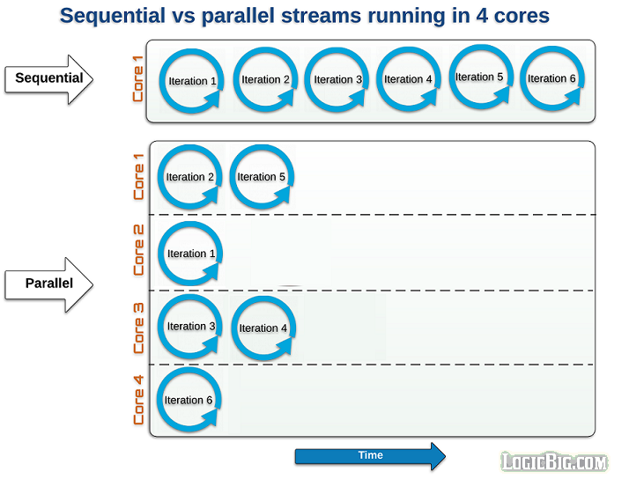

Slide 24
Stream Important Methods
forEach() : to iterate each element of the stream.
forEachOrdered() : to iterate with parallelStreams for guaranteed order.
map(): to map each element to its corresponding result.
filter() : to eliminate elements based on a criteria.
iterate(): to get an infinite Sequential ordered stream
limit() : to reduce the output size of the stream.
sorted(): to sort the stream
reduce() : takes all elements combines them to single result

Slide 25
Stream Methods
https://docs.oracle.com/javase/8/docs/api/java/util/stream/Stream.html
Intermediate Operations
Filter
Map
Stream<T> filter(Predicate<? super T> predicate)
Returns a stream consisting of the elements of this stream that match the given predicate.
<R> Stream<R> map(Function<? super T,? extends R> mapper)
Returns a stream consisting of the results of applying the given function
to the elements of this stream.

Slide 26
Stream Methods
Terminal Operations
forEach()
collect()
match()
count()
reduce()
Min(), max()
anyMatch(), noneMatch()
Short-circuit Operations
anyMatch()
findFirst()
.

Slide 27
Optional
Optional is a container object used to contain not-null objects.
Optional object is used to represent null with absent value.
It is used to deal with NullPointerException in Java application.
New class added to java.util package.
Why Needed?
It provides methods which are used to check the presence of value for particular variable
Important Methods:
Get()
orElse()
orElseGet()
ifPresent()
isPresent()
Empty()

Slide 28
Exercise/Assignment

Slide 29
Thank You

